Slide 1

Object Oriented Programming Language (Opps)
Presented by,
Vishal m. Tawar

Slide 2



Agenda
Introduction
Object
Class
Encapsulation
Inheritance
Polymorphism
Abstraction

Slide 3




Introduction
Object Oriented Programming is a para-diagram , where we take all real time example and convert into programatical word.

Slide 4


Object
A Java object is a member (also called an instance) of a Java class. Each object has an identity, a behavior and a state. The state of an object is stored in fields (variables), while methods (functions) display the object's behavior.

Slide 5
Class
A class is used in object-oriented programming to describe one or more objects. It serves as a template for creating, or instantiating, specific objects within a program. While each object is created from a single class, one class can be used to instantiate multiple objects.

Slide 6
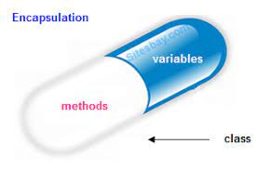
Encapsulation
It is procces of bindind between properties and bahavior of an object is classed as Encapsulation
Data Hiding
Private Keyword
Getter Method
Setter Method

Slide 7
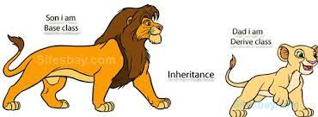
Inheritance
It is a process of acquiring the properties and behaviour of parent class to child class is called as Inheritance.
Extends Keyword
Single Level Inhetance
Multi Level Inhetance
Hierarchical Inhetance
Multiple Inhetance
Hybrid Inheritance

Slide 8
Single Inheritance
Class A
super()
Single Level
exteds
Class B
super()

Slide 9
Multi Level Inheritance
Class A
super()
exteds
Class B
super()
exteds
Class C
super()

Slide 10
Hierarchical Inheritance
Class A
super()
extends
extends
Class B
super()
Class C
super()

Slide 11
Multiple Inheritance
Class A
super()
Class B
super()
extends
extends
Class C
super()

Slide 12
Hybrid Inheritance
Class A
super()
extends
extends
Class C
super()
Class B
super()
extends
extends
Class D
super()

Slide 13
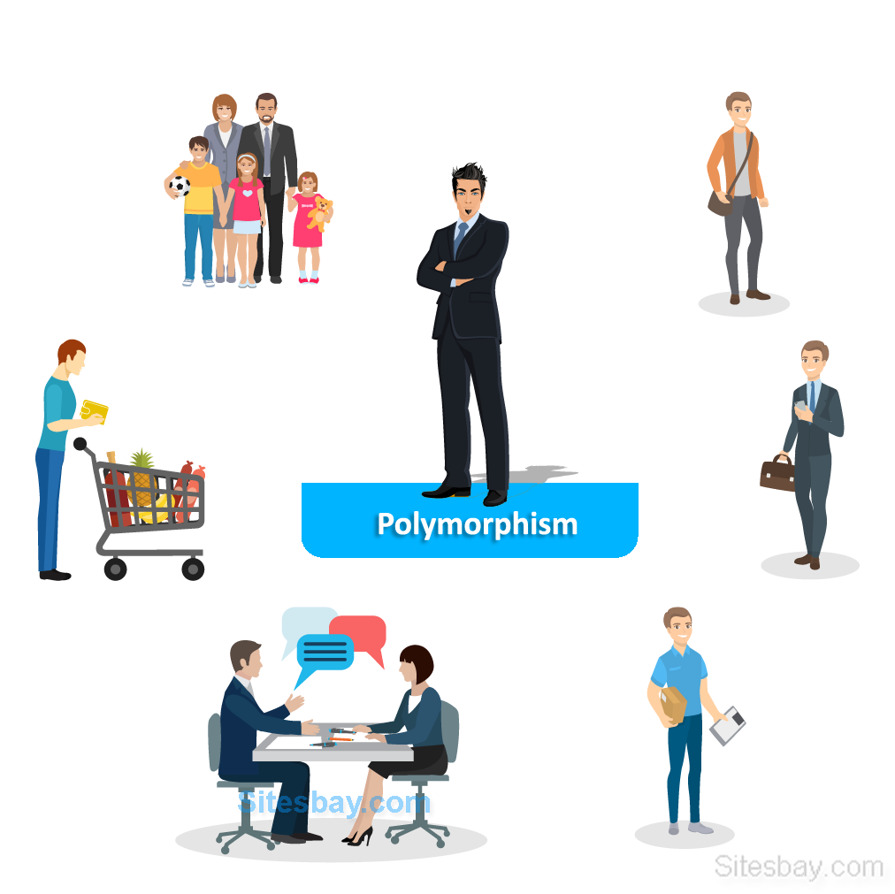
Polymorphism
An object exbiting or performing more than one form is called as polymorphism.
Compile Time Polymorphism
Method Overloding
Constructor Overloding
Run Time Polymorphism
Method Overriding
Method Hiding

Slide 14

Absraction
Absraction it is a process of hiding Implimantation
We can perform abstraction process with the help of “abstract” Kyeword.
Concrete Method
Abstract Method
When a class consist of at list it’s one abstract method ,then it’s mandatory to make the class as abstract.

Slide 15
Any Question ?

Slide 16


Thank You
By,
Name:- Vishal Malkhan Tawar
Email Id:-VISHAL.TAWAR@CAPGEMINI.COM
Employ Id:- 46195773

